Slide 1
ASUS CENTER PRESENTS
ASUS TRANSFORMER AiO
Demo App
Prepared by ASUS | 2013. 06.14

Slide 2
CONTENTS
01. Timeline
02. Demo App Introduction
03. Active Demo App
04. Demo App Content
05. FAQ

Slide 3
Timeline

Slide 4
Timeline
Phase I Release | Phase II Install and Demonstration |  | Phase III Feedback and Review
Mid Jun | End Jun- End Aug |  | Sep (W36) | Sep (W37)
Guideline and app release | Demonstration | Preload ready | Territory feedback | Review feedback
HQ Release Demo SOP App File Download: ASUS DEMO Program Resource Site http://www.asus.com/microsite/demo/default.htm#/list or Channel site | Promoter installation Shop deco | Global version implemented on P1801 MP units shipped from July (W27) | Collect feedback from territory | Review feedback
 | Localization
 | Local MKT submit request of language to HQ MKT by Jun/E (W26) HQ MKT update localization plan/status

Slide 5
Demo App Introduction

Slide 6
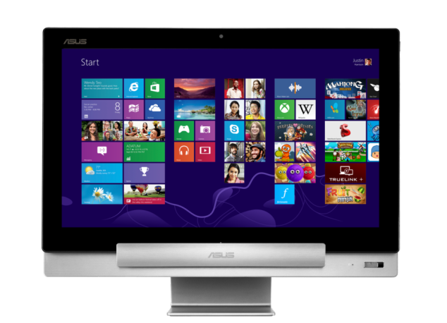
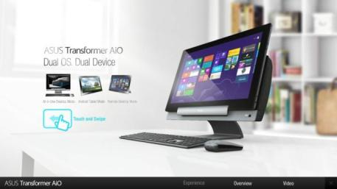
Demo App Purpose
Demo App Purpose
Demo screen only shows Window 8 interface or product video
Every Windows 8 display shows the same image
More interactive user experience
FAB can be explained in more detail by videos and images
More eye-catching
Before
NOW

Slide 7
Active Demo App

Slide 8
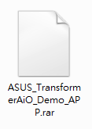
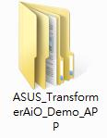
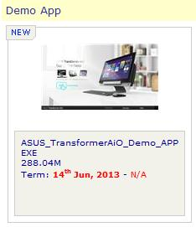
Active Demo APP
Step1: Download the Demo App for promoters
1
Download the Demo App.
2
Unzip the file.
Channel Site
Marketing Resource → Products → All-in-One PCs→ 18 inch > P1801
※ Please DO unzip the file before providing it to promoters.

Slide 9
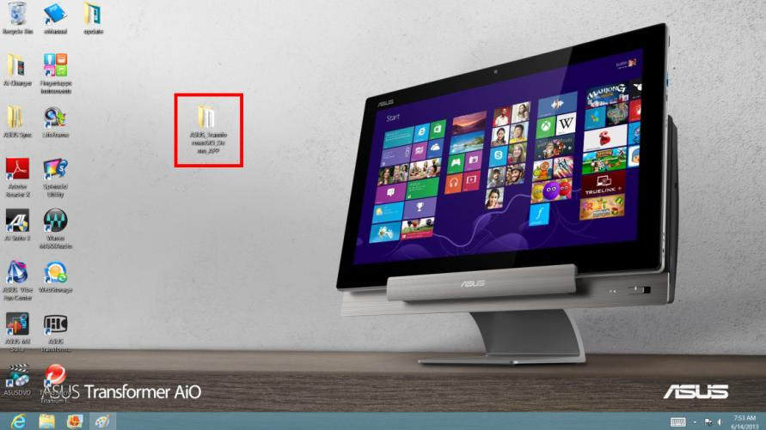
Active Demo APP
Step2: Install the Demo App
1
Copy the Demo App folder to the Desktop (in desktop mode).

Slide 10
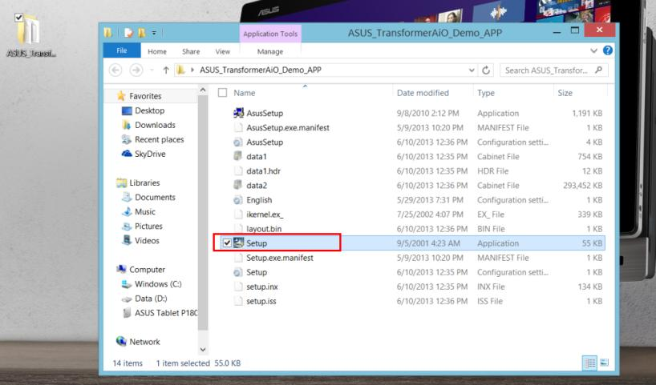
Active Demo APP
Step2: Install the Demo App
2
Open the folder and double-click “Setup” to install

Slide 11
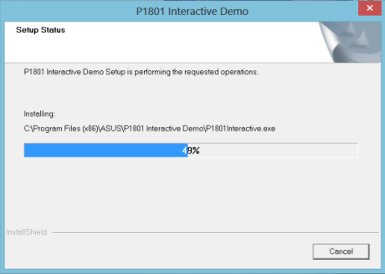
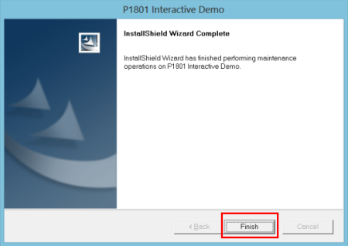
Active Demo APP
Step2: Install the Demo App
3
Press “Finish” when the installation is finished.

Slide 12
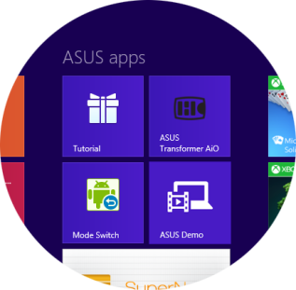
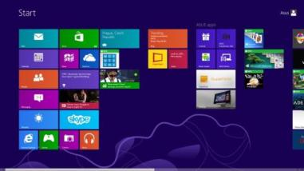
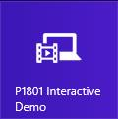
Active Demo APP
Step3: Go to the Start Screen and Click the Tile

Slide 13
Active Demo APP
Step4: Start the Demo.

Slide 14
Demo App Content

Slide 15
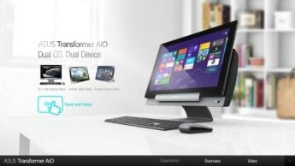
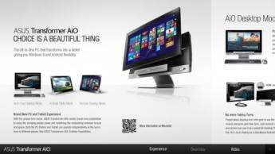
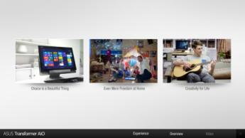
Demo APP Content
Experience
(Default Page; Refresh automatically after 30sec of idle time. )
Overview
(Redirect to Experience page automatically after 30sec of idle time..)
Video
(Redirect to Experience page automatically after 30sec of idle time..)

Slide 16
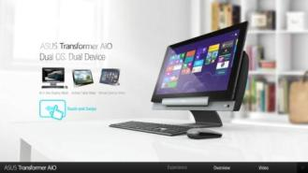
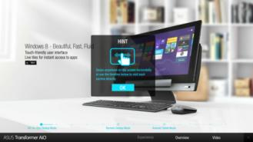
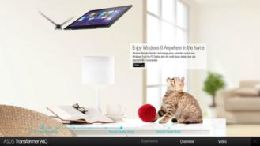
Demo APP Content
Experience
Start the demo
Hint : Click OK to hide
Click to show feature in details

Slide 17
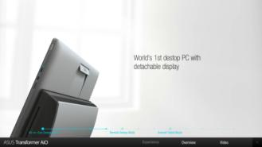
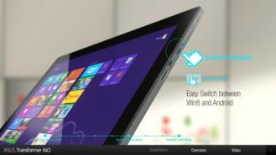
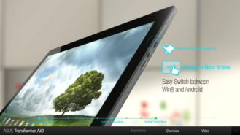
Demo APP Content
Experience
Timeline: Click the point to jump to each section directly.
OS Switch: Click the Mode Key to next section
OS Switch: Click to back

Slide 18
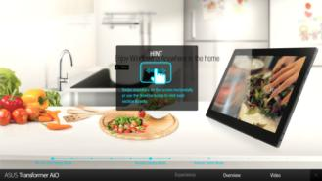
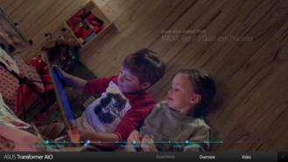
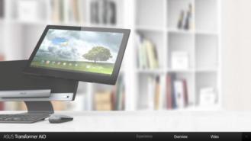
Demo APP Content
Experience
Hint : Show automatically after 5sec of idle time. Touch the screen to hide hint window.
Film section: “Swiping” is not functional.
Redirect to start

Slide 19
Demo APP Content
Overview
1. Swipe to read content.
2. Redirect to Experience automatically after 30sec without any action.

Slide 20
Demo APP Content
Video
Click to choose video.
Redirect to Experience automatically after 30sec of idle time.

Slide 21
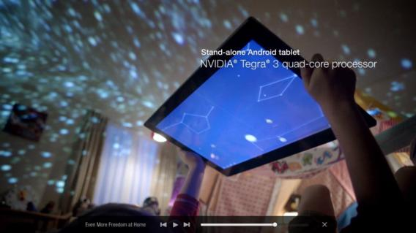
Demo APP Content
Video
Click or drag the timeline
The bar hide automatically after 5sec of idle time. Touch the screen to show again.
Click to change video

Slide 22
FAQ

Slide 23
FAQ
FAQ
Q1. Will support for other AiO PCs be added later?
BU / HQ MKT have collected the initial feedback regarding demo content / suggested models / execution from sales. Will update the plan and status in the near future.
Q2. How many languages will the app support?
Please pass your request of language to HQ MKT by Jun/E. HQ MKT will further consolidate/evaluate the requests and release the multi-language implementation plan.
Q3. Do we have to keep demo units online?
No. All data and information is ready and pre-installed in the app. P1801 Demo App doesn’t require an internet connection while running.

Slide 24
FAQ
Q4. Will the demo app be preloaded to the MP units?
Yes. The preloading will be phased into the production by the end of June. Therefore, all P1801 units shipped after WW27 will be preloaded with the demo app (global version).

Slide 25
THANK YOU
Please contact ASUS for further assistance

