Slide 1

Live Demo – Channel Sales eCommerce SOP
TPM : Vivian1_Chang

Slide 2
Data key-in @ e-Commerce:
Easy 2 steps!!
Step1 . Receive the template with S/N & Mac Address from merchandiser
Step2. Key in the mac address and serial number in e-Commerce
Note!
Each demo unit (Mac Address & S/No.) should match each demo store

Slide 3
Step 1：Find the S/N & Mac Address
Branch:
Country | Channel Type | Individual Store Data of Ecommerce account (to deploy Live Demo 1.0)
 |  | Company (Customer) Name* | Store English name | Company ID | Firmware Serial No. | IP Mac Address | Channel Sales Feedback Status
NL | A. Retailer | Media Mxxt | Media_Office Centre Zellik | 4900090678 | QTCYFV60A2470002A | b0:ee:45:b0:6a:a3
NL |  |  | Media_MOBILE ACCESS N.V. | 4900090894 | ABIYFV50A29323402E | t4:we:45:b0:9a:e0
BE |  | Caxxefoux | Caxxefoux_MyCom Online BE | 1234850590 | ETRSFV60A2470015R | w0:re:76:b1:3h:a7
BE |  |  | Caxxefoux_Office Centre Eke | 3957103775 | CSGTEV60A2470002A | b2:ee:45:b2:6a:i6
 | B.Reseller/AC

Slide 4
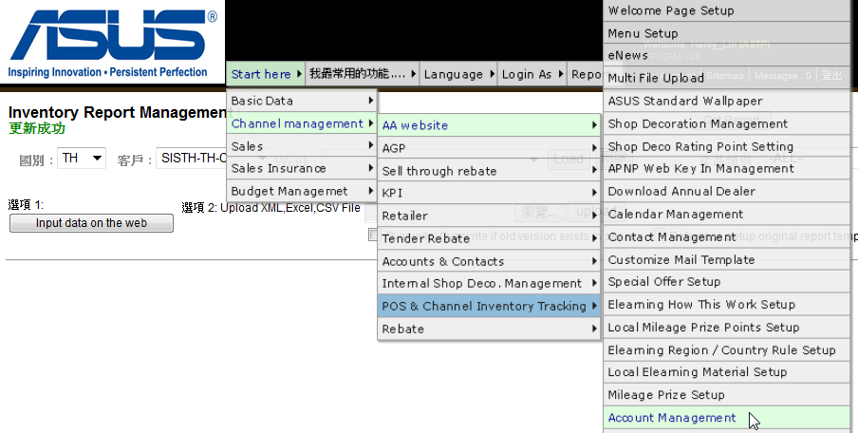
Step 2： Key in the Mac address and S/No. in eCommerce p1/6
Go to Account Management in eCommerce : http://ecommerce.asus.com.tw/

Slide 5
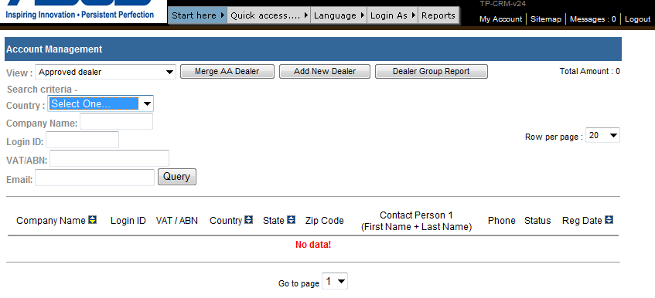
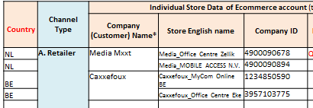
Step 2： Key in the Mac address and S/No. in eCommerce p2/6
1. Select [Approved dealer]
4900090678
2. Select your country
Key in Company ID to “Company Name column” from the template

Slide 6
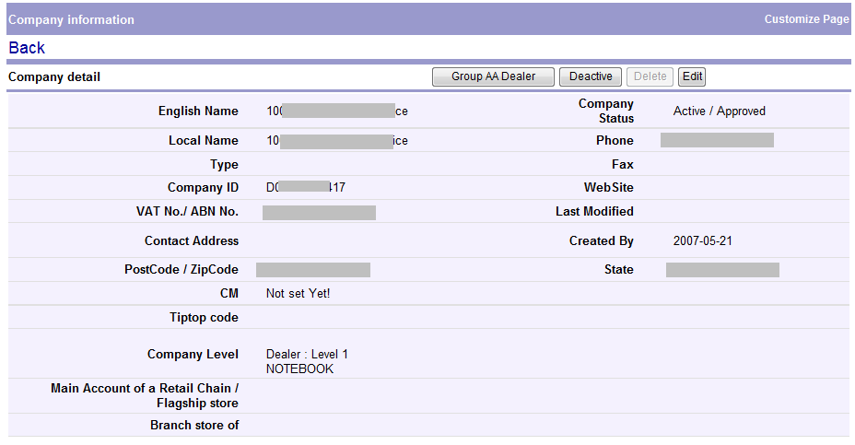
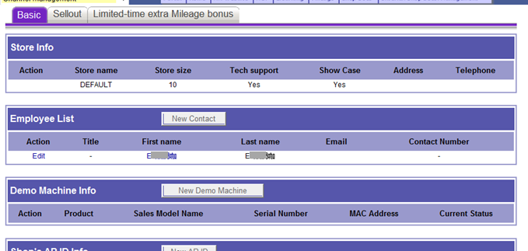
Step 2： Key in the Mac address and S/No. in eCommerce p3/6
You will enter Company detail page.
3. Scroll down till you see this section of
[Basic] → [Demo Machine Info]
4. Click [New Demo Machine] to start key in

Slide 7
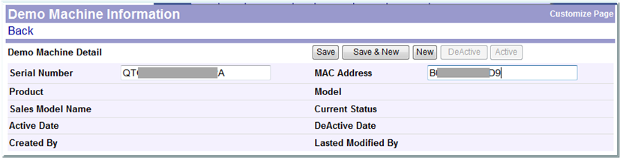
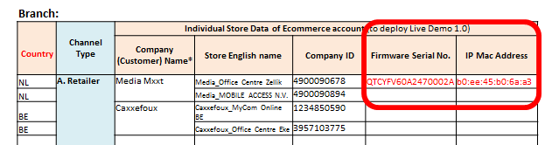
Step 2： Key in the Mac address and S/No. in eCommerce p4/6
6. Then click [Save]
5. Key in [Serial Number] and [MAC Address] from Template

Slide 8
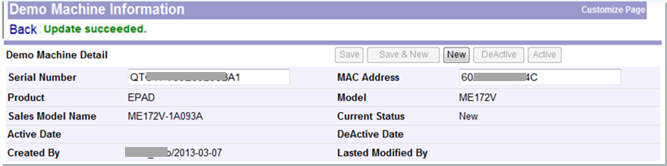
Step 2： Key in the Mac address and S/No. in eCommerce p5/6
Registered successfully
If registered successfully, then system will respond a message here
And the machine status will be shown as “New” here.

Slide 9
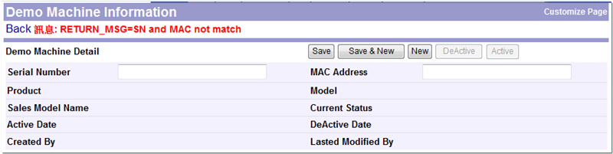
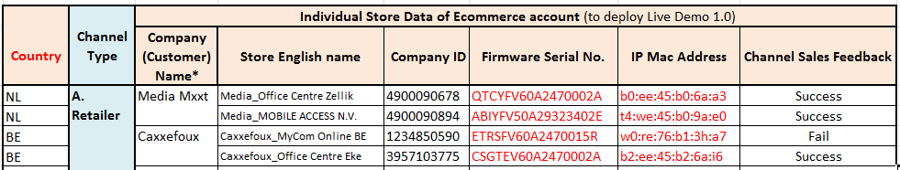
Step 2： Key in the Mac address and S/No. in eCommerce p6/6
Registered failed
If fail to registered, then system will respond with a message here.
Then the page will be refreshed as blank .
Please make sure S/No. and Mac address key-in correctly

Slide 10
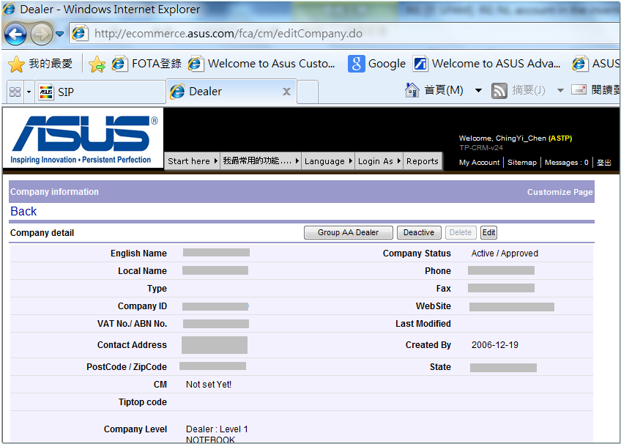
Notice!!
If you want to switch to another account, then you can just click here for going back to previous page with the previous searching criteria.
If you click “Back”, then you will go back to the “searching page” without the previous criteria setting .

Slide 11
Appendix
How to find store ecommerce account?
The meaning of the “Current Status” field in Ecommerce Account Management.
What to do if you registered a machine in wrong shop’s account?

Slide 12
How to find store ecommerce account?

Slide 13
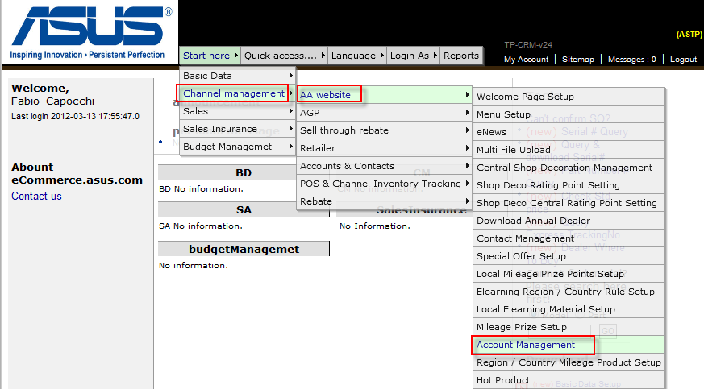
How to find store ecommerce account? p1/3
Link to: http://ecommerce.asus.com.tw/
Step 2 : Select “AA website”
Step 1 : Select “Channel management”
Step 3 : Select “Account Management”

Slide 14
How to find store ecommerce account? p2/3
Step 4 : Select “Approved dealer”
Step 5 : Select search criteria
Step 6 : Click to query

Slide 15
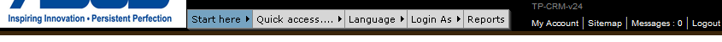
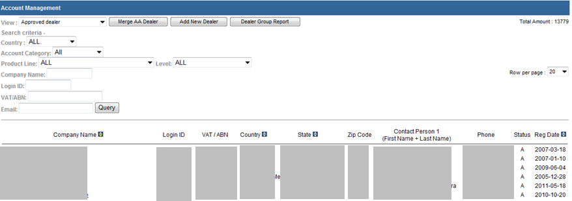
How to find store ecommerce account? p3/3
Step 7 : Select Company Name.
Find Company name and Company ID

Slide 16
How to Deactive a machine from being a “Demo machine”?

Slide 17
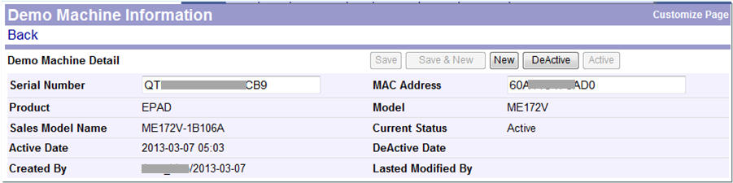
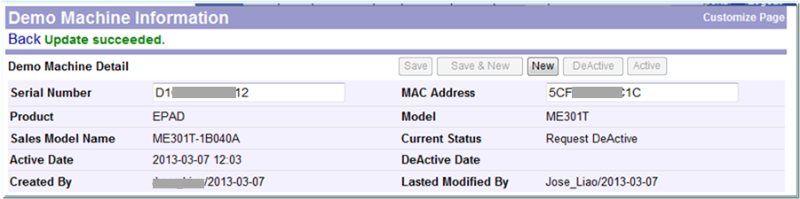
How to Deactive a machine from being a “Demo machine”?
Go to Account Management in eCommerce : http://ecommerce.asus.com.tw/
1. Only when the “Current Status” is “Active”, then the button of “Deactive” will appear.
2. Click the button of “Deactive”.
Once here shows as ”Request Deactive”, means: Ecommerce has request FOTA server for the Deactive.

Slide 18
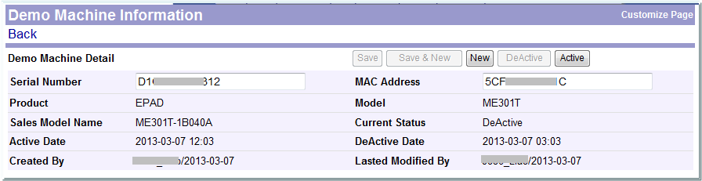
How to Deactive a machine from being a “Demo machine”?
Only when here becomes as ”Deactive”, means:
FOTA server has remove this machine’s registration from the list.
And the machine has been removed with the Demo app.

Slide 19
The meaning of the “Current Status” field in Ecommerce Account Management.

Slide 20
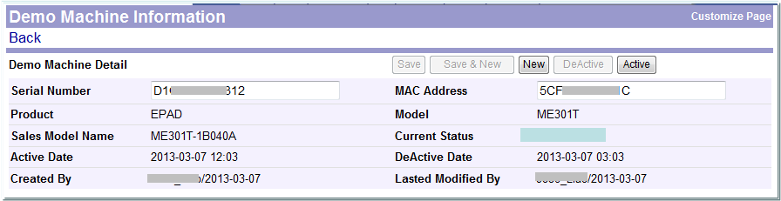
Currently there are 4 kinds of status in the “Current Status” field:
New
Active
Request DeActive
DeActive
“Current Status” field shows as: | The meaning of each status
New | Meaning your machine is registered into FOTA server successfully and just waiting for FOTA server pushing the “Demo App” into the machine.
Active | Meaning your machine is already installed with the “Demo App” successfully, and just starting to download the “contents of videos” from server.
Request DeActive | Meaning: you have click the button of “Deactive” on the Ecommerce page (as shown in page 18), and Ecommerce is now sending a request to FOTA server for removing this machine from the Demo List. And Ecommerce is waiting for FOTA server’s response.
DeActive | Meaning: FOTA server has received the request of removing this machine from the Demo List. And, FOTA server has done this request from Ecommerce for this machine. This machine is removed from the FOTA server’s Demo List.

Slide 21
What to do if you registered a machine in wrong shop’s account?

Slide 22
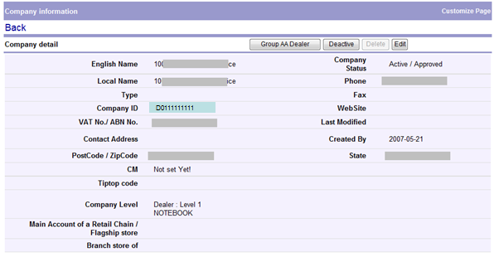

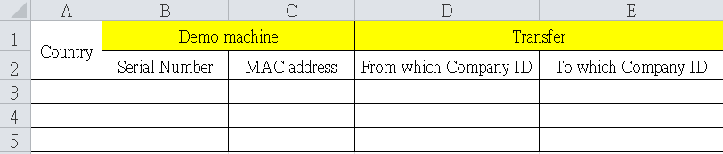
If you accidently register the machine’s S/N and MAC address to a wrong account, please apply ITRS to MIS for applying to transfer the machine’s S/N and MAC address to the correct account.
Wrong account
Correct account
Step1. Fill in all fields in the attached Apply Form with information:

Slide 23
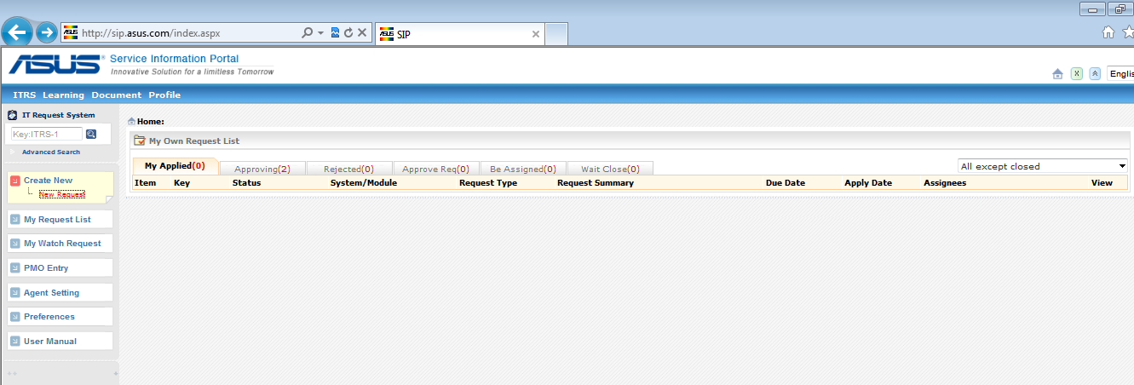
Step2. link to http://sip.asus.com/index.aspx
Step3. Click “New Request”

Slide 24
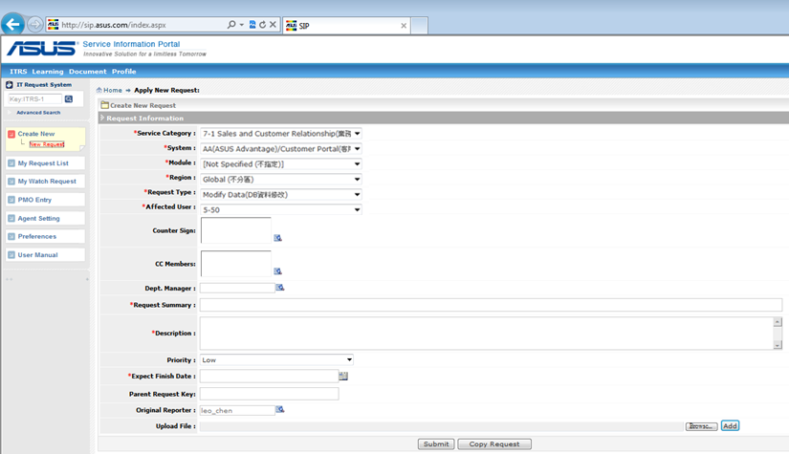
Step4. Set the criteria like this:
Step5. Fill-in the Request Title like this:
Step7. Set the Priority and the Expected Finished Date by your needs.
Step6. Fill-in the Request Summary like this:
Request for transferring Demo machine to the correct account.
Request for transferring Demo machine to the correct account. Details as the attachment.
Step8. Browse and Upload the “Apply Form” done in step1.
Step9. Click “Submit” and get the ITRS no..

Slide 25
Thank you

